Slide 1
Response time and
Service Demand
Lei Sun
Oct, 2015

Slide 2
Agenda
Background
Little’s Law and its implication
Factors impacting response time
  Service Demand
  Topology
  Visit distribution
  Parallel processing
Service Demand measurement
Q&A

Slide 3
Background (1)
There are two major metrics in performance test
  Response time
  Throughput
For end-customer, response time is the only factor
  End-customer does not care about throughput (unaware of the existence of other end-users)
  Throughput is only important for site owner (capacity planning)
However, there is linkage between the two!

Slide 4

Background (2)
The component of Response Time
For web system (e.g. WC)
  Network latency is the biggest part of end-user response time
  Browser time (rendering) is also big part for Web 2.0 page
  Lab performance testing is focused on server side
  The discussion in this slide is focused on server side response time (although the principle applies for the whole round trip)
It is nearly impossible to simulate/test end-customer response time of WC within Lab environment!
Notes:
Why CDN is important?
Why it is important to reduce page size?
Why it is important to reduce round trip number?
Why it is important for lazy load/parallel load for store front UI?

Slide 5
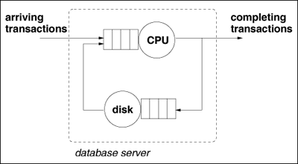
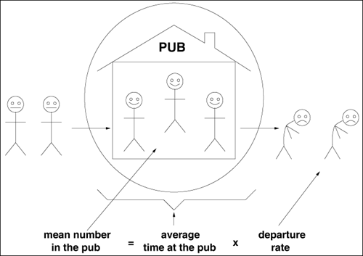
QN model and Little’s Law (1)
QN model is the common theory model to simulate software system (simplified)
Little’s law is a powerful tool for response time calculation
  It is not dependent with the accuracy of the QN model

Slide 6
QN model and Little’s Law (2)
Basic formula of Little’s law
  N (concurrency) = X (throughput) * R (response time)
Example application
  A performance testing of WC is running, throughput is 7.8 PV/s. TPV shows average active connection to WC server (standalone WAS) Web container is 11. What is the average response time of every WC page on WAS tier?
R=N/X=11/7.8=1.4 sec (no need to monitor the servlet response time in TPV!)
  If every page is composed of 4 Web interactions (HTTP hits), what is the impact to the conclusion?
Notes:
X=11*4, R=1.4/4

Slide 7
QN model and Little’s Law (3)
Implication of Little’s law
  For similar workload (throughput), the less concurrency number, the better response time (let alone considering the benefits for less lock contention)
Best practice
  For connection pool tuning, we should set max pool size as small as possible (while big enough to use all HW capacity).
  E.g. if the all the application logic is running on app server, we should set connection pool size equal to CPU/core number (or SMT thread number when SMT is enabled). If there is logic for other tier (e.g. DB server), initial setting can be 2x CPU/core number (assume 50% threads are waiting for other tier processing).

Slide 8
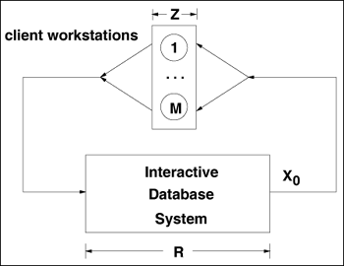
QN model and Little’s Law (4)
Interactive Response Time Law
  R = M (User number) / X - Z (think time)
Example application
  In a benchmark testing of WC, stress test shows max throughput we can get is ~600 PV/s. Formal testing will be done with 6000 VU (RPT client). Performance target is to achieve similar throughput with the best response time (~3s). How to set Think Time in RPT?
Z=M/X-R=6000/600-3=7 sec
  Shorten think time will just cause longer response time!
RPT response time result is impacted by the Think Time setting!
Notes:
7s is just initial value, actual optimal TT should be calibrated based on actual test result.

Slide 9
Factors impacting response time (1)
Little’s Law is valid without considering:
  Difference between requests (multi-class workload)
  Queuing management strategy
  HW/SW topology
  Workload distribution pattern
  …
Those factors are critical to low-level response time performance, while Little’s Law can only provide high-level estimation (average response time). Little’s law also provides link between response time and throughput, which is determined by Service Demand Law.

Slide 10
Factors impacting response time (2)
Service Demand Law:
  D (Service Demand) = U (utilization) / X
For multi-tier system: D_{i} (i tier out of n tiers)
  R >= SUM (D_{i}) (assume sync processing)
  X₀<=1/Max{D_{i}} (U <= 1)
  Multi-tier system performance is determined by the slowest tier (bottle-neck)

Slide 11

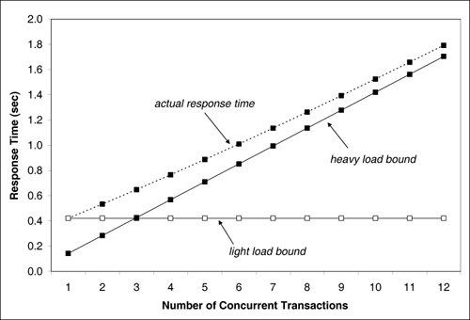
Factors impacting response time (3)
Lower bound of Response time:

Slide 12
Factors impacting response time (3)
For specific simplified QN model, there is formula to solve response time. For example, solving Markov model:
  R = D / ( 1 – U )
Why it is important to reduce Service Demand for better response time (D ↓, U ↓)

Slide 13
Factors impacting response time (3)
Former formula (R = D / ( 1 – U )) is applicable for single queue (server). What is the impact of clone/clustering (multi-CPU or multi-server)?
  Total workload is the same, assume evenly distributed load-balancing. Each CPU/Server takes 1/n traffic
  Is response time the same for two configuration: a) 1 server, b) 2 servers which are 2 times slower?
    a) has better response time (U is the same, D is ½)
Where using high-end (high CPU frequency) server is helpful for performance!

Slide 14
Factors impacting response time (4)
The assumption of Markov model is “exponential distribution” (visit distribution)
  Real world workload is near exponential distribution
  Most workload generated by test tool (e.g. RPT) is near “constant distribution”: constant Think Time. Using “random think time” will get better response time distribution (Standard Deviation).
Think time distribution in RPT affects response time result!

Slide 15
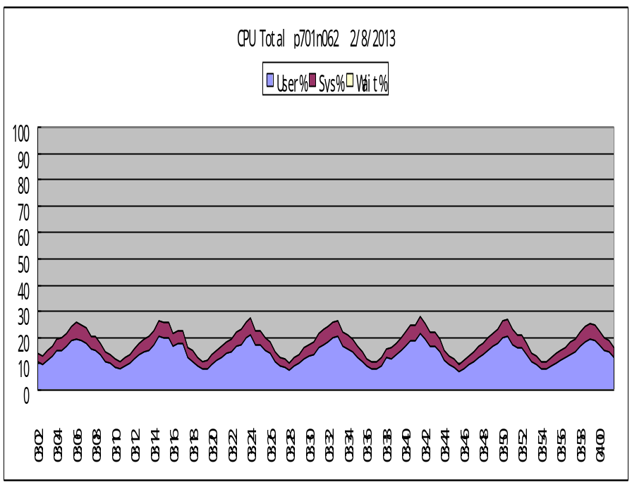
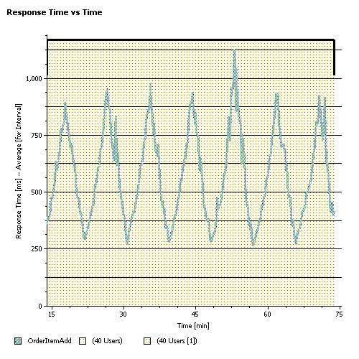
Factors impacting response time (5)
Composite workload is multi-class. The distribution of different class page affects response time
  Resonance (spikes) of response time caused by “marching” of pages
Use “wrap-up” stage to distribute visit of different page evenly!
Notes:
The workload is large cart (50 items) scenario: the whole transaction includes 50 pages of OrderItemAdd, each time add 1 (from the 1st) item to the same cart. Each page will be heavier than the former page.

Slide 16
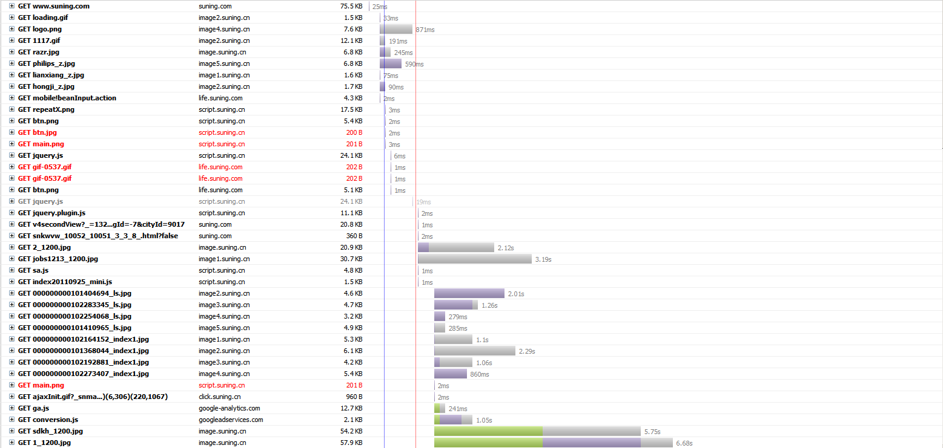
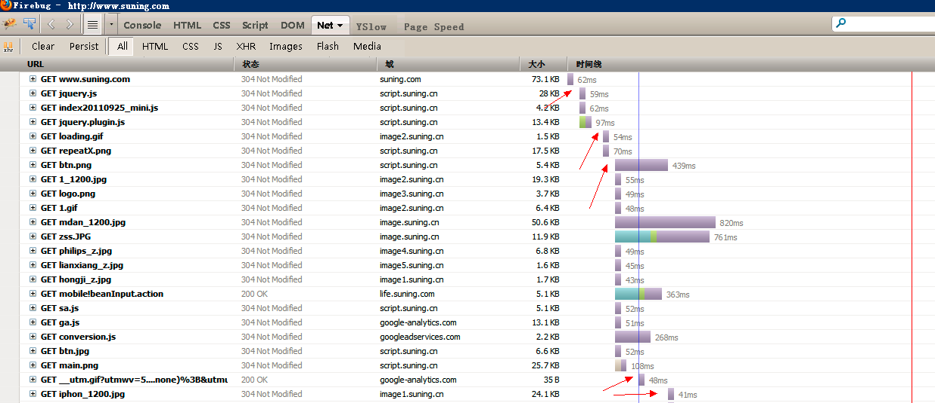
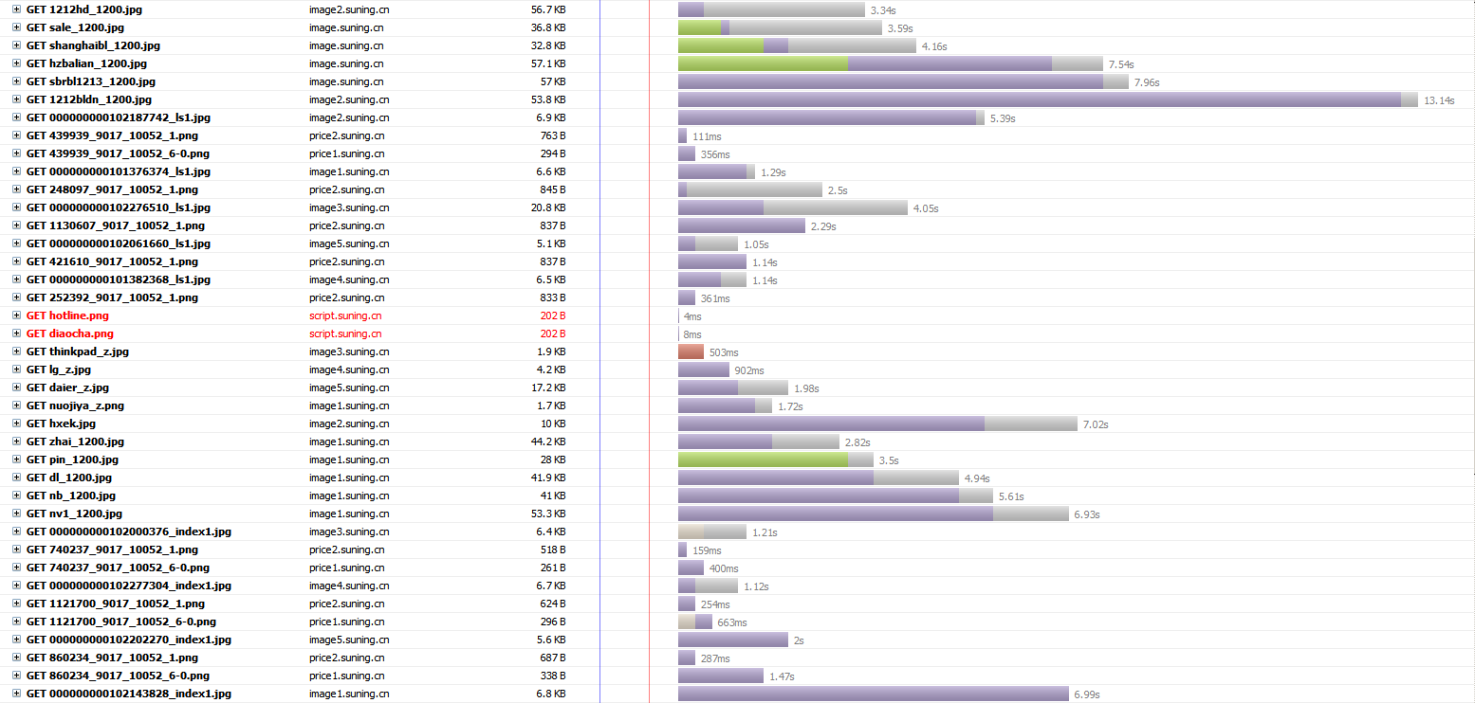
Factors impacting response time (6)
The assumption in former section of “sequential processing” in different tier (part). Does it helpful to use “parallel processing”?
Example: best practice of front-end performance (load model)

Slide 17
Factors impacting response time (7)
Where “parallel processing” works
  Truly “parallel” rather than “concurrent”
  “server side” is under-utilized
Where “parallel processing” does not work
  “Concurrent/sequential processing” in “server side”
  “server side” is over-utilized (e.g. parallel downloading does not help in overloaded network)
What really helps response time
  Non-blocking (Async) processing
  Lazy-loading (do not do computing not needed), background loading

Slide 18
Service Demand measurement (1)
The SD measurement is also done using Service demand law
  The measurement test are stress tests on controlled hardware. Throughput (X) and Resource Utilization (U) are measured.
    Stress means 0 think-time, high (near 100%) resource usage
    Concurrent user number is not important
  SD is calculated by SD = U / X
  Current WC CPT only measures SD on CPU and Disk I/O, but it can be used to measure other cost like network usage

Slide 19
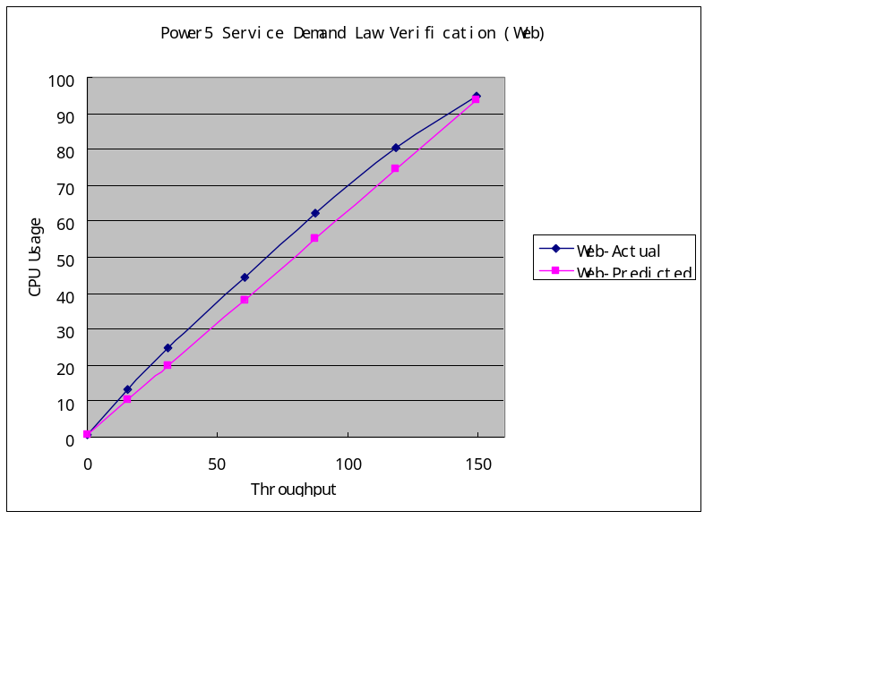
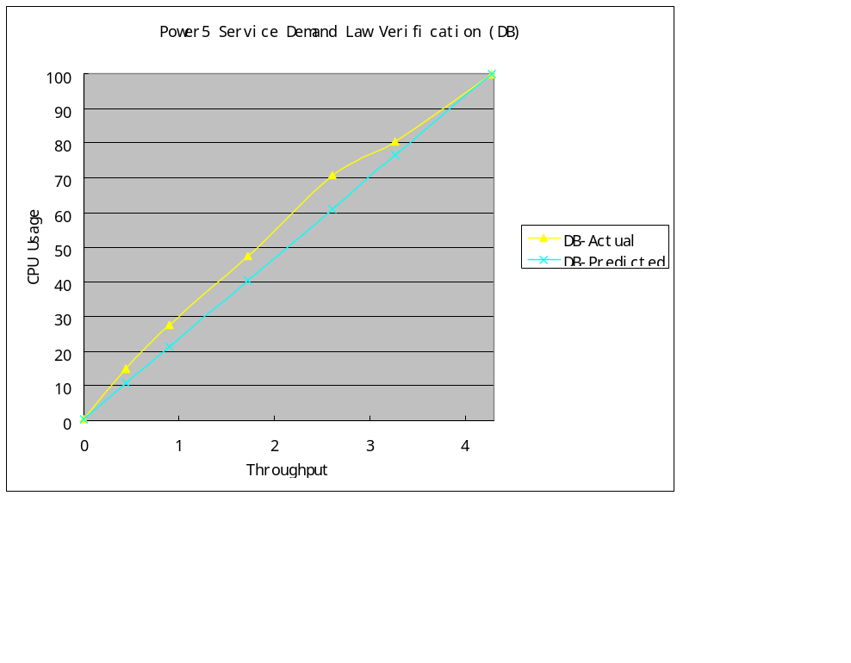
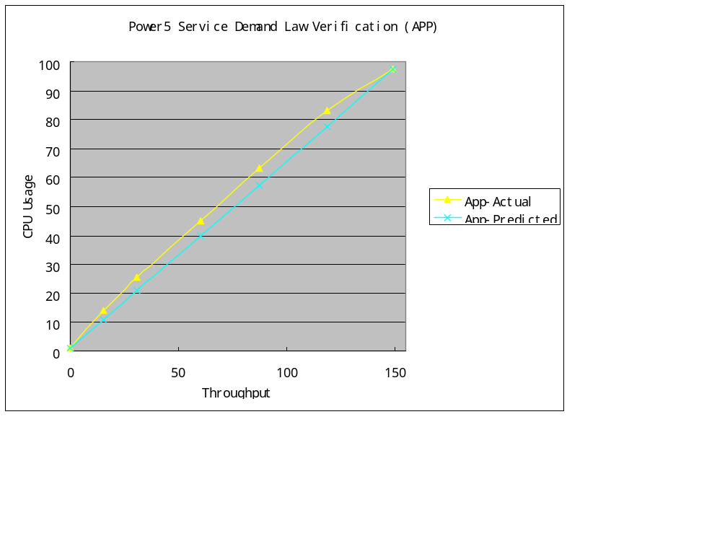
Service Demand measurement (2)
Why high resource usage is important
  Service demand law indicates the “cost” should be a constant, but we rely on CPU (and other resource) usage monitoring tool to capture the result
  CPU usage curve may not be ideal straight-line

Slide 20
Service Demand measurement (3)
What does it mean for performance test
  For SD measurement test, the lower the system CPU usage, the bigger error-margin for test result. So we should drive the resource usage as high as possible (stress)
  For multi-tier test environment, we should push CPU on ALL tiers as high as possible, it is why CPT changes HW configuration of different tier for different scenario

Slide 21
Take-away about response time and SD
Response time is impacted by many factors
  Most never been considered by tester, or beyond tester’s control
  Testing result focused on response-time ONLY may provide misleading conclusion
Service Demand test result is much more stable
  SD measurement is more suitable for release to release comparison
  Try to stress the system to get more accurate result

Slide 22

Q&A

